Slide 1
BUZZIN
News and Weather app
SHAURYA PRATAP SINGH

Slide 2
What is the need for this app? Why mobile?
To plans journeys ahead.
To plan meetings.
To stay updated about the events happening in the world
Sometimes people need to pass their time and they usually scroll their phones to do that. So, scrolling through news cards is more productive.
There is a vast majority of people who uses smartphones these days.

Slide 3
So a good news and weather app should..
Provide weather information in clear ,crisp and easy to understand manner.
Show weather forecast at different time and day.
Be able to show weather forecast at different places.
Be able to provide news from different sources.

Slide 4
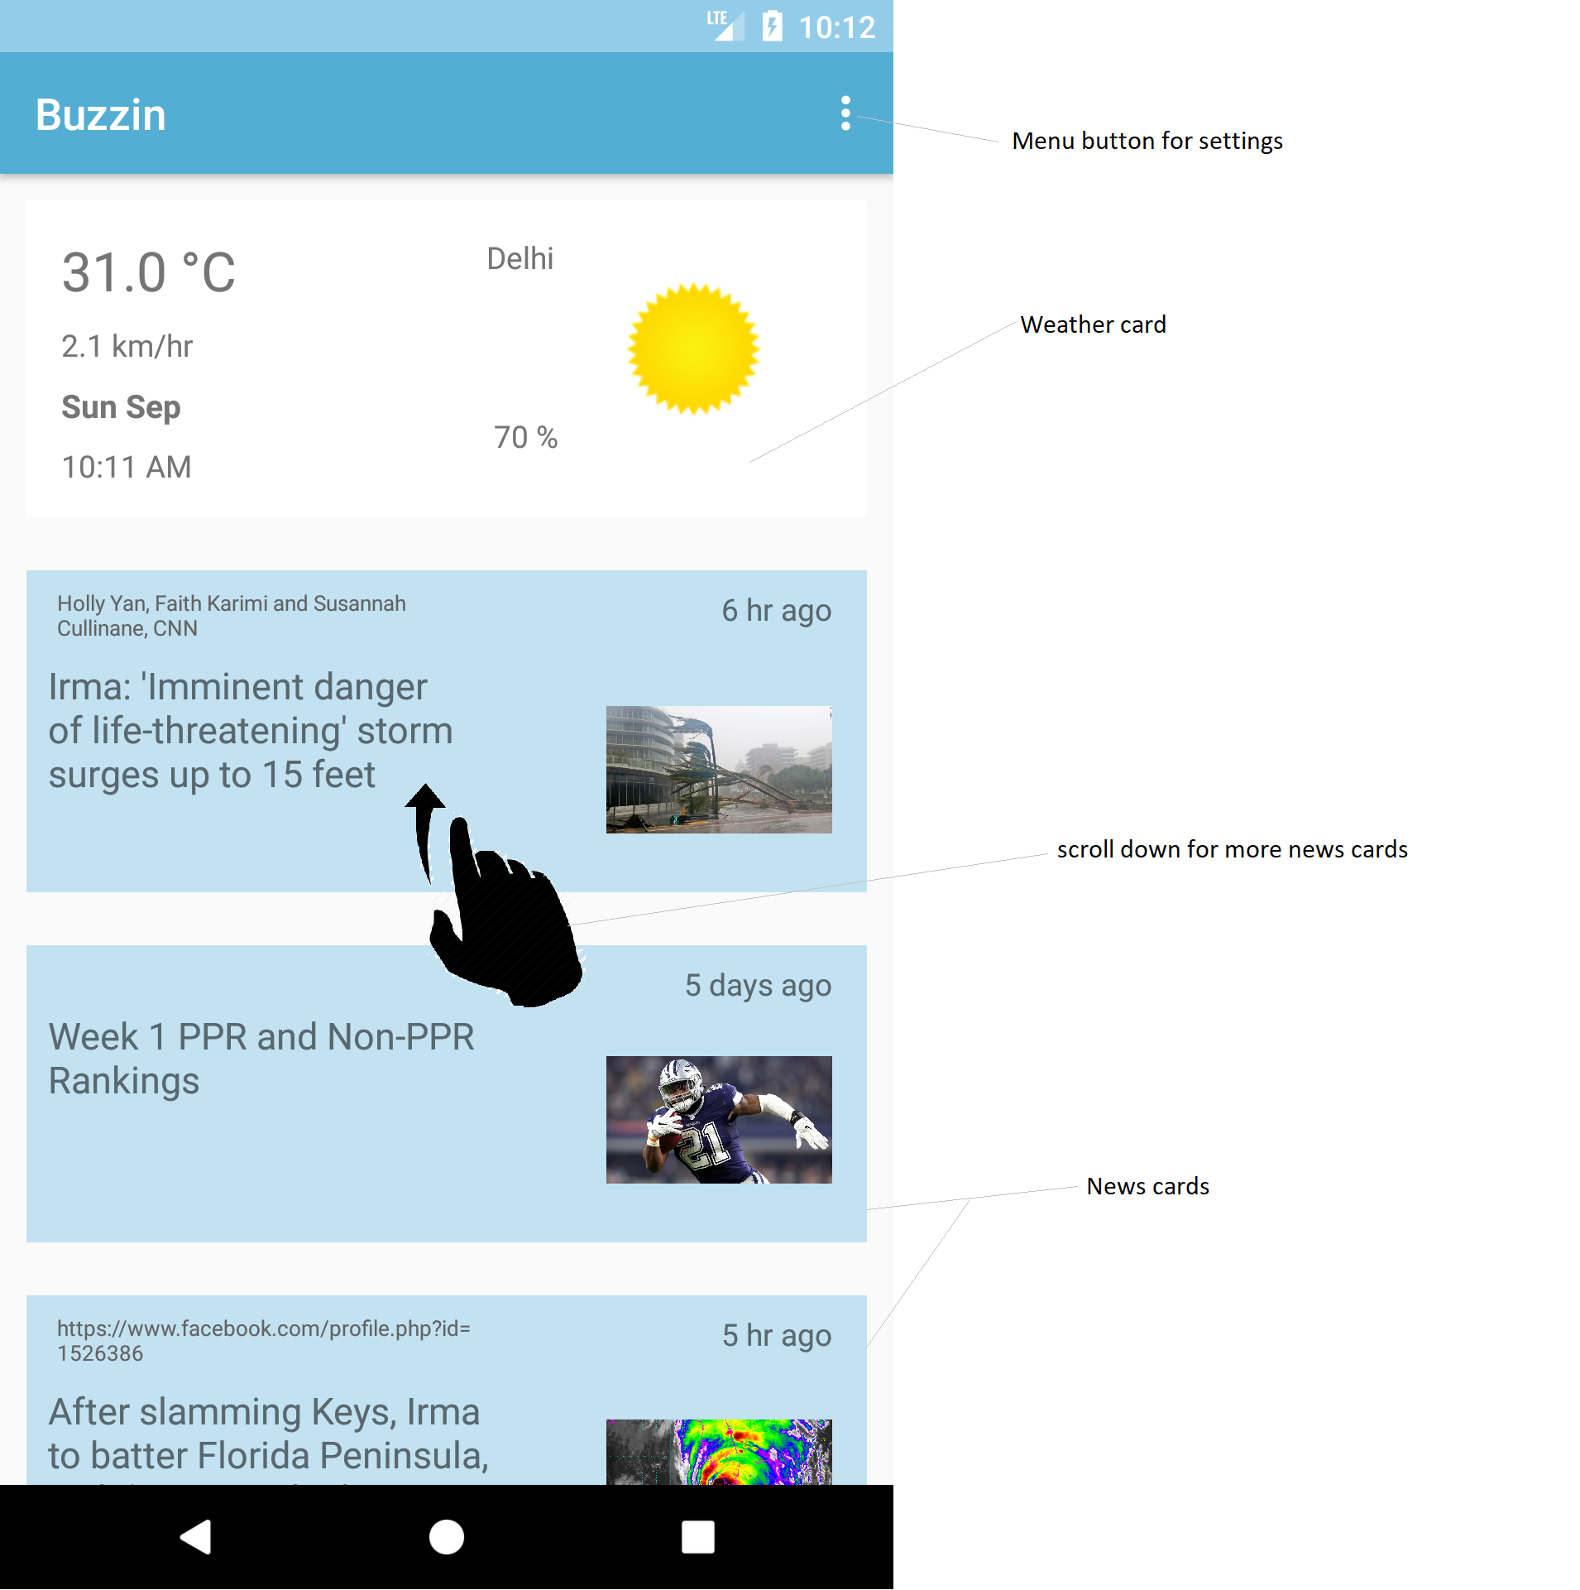

Slide 5
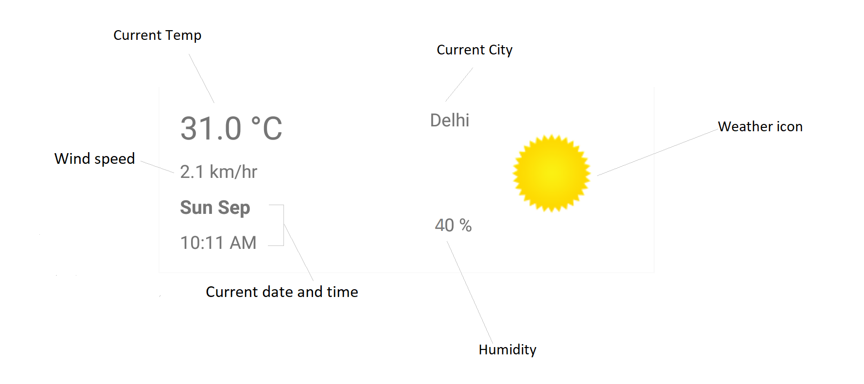

Slide 6
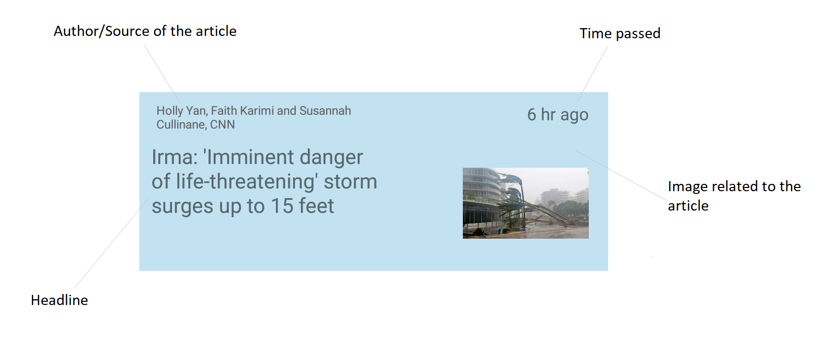

Slide 7
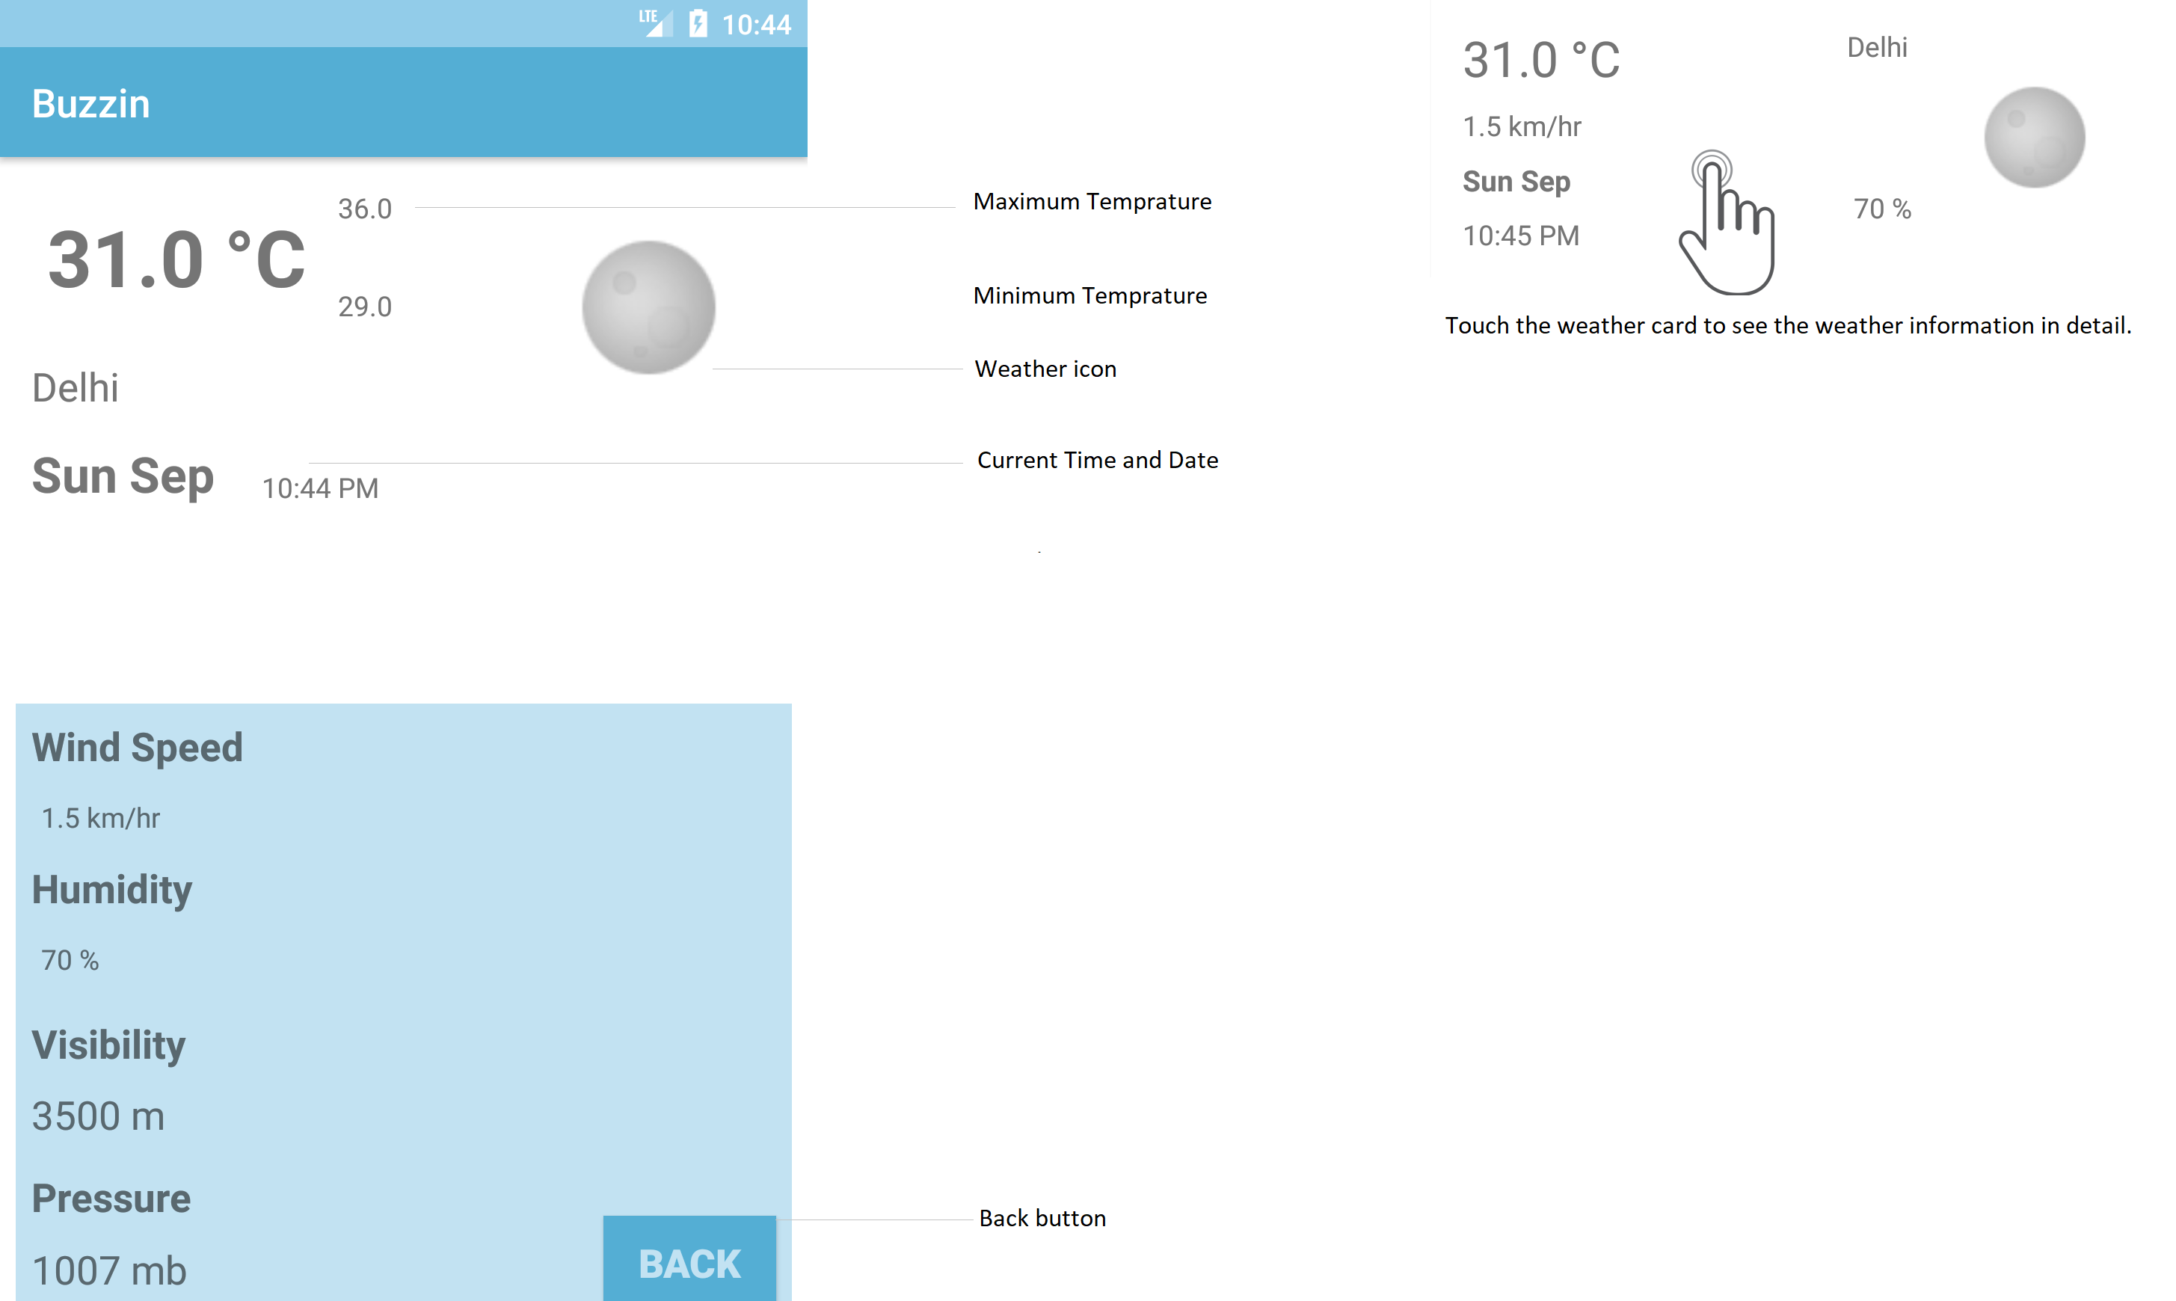

Slide 8
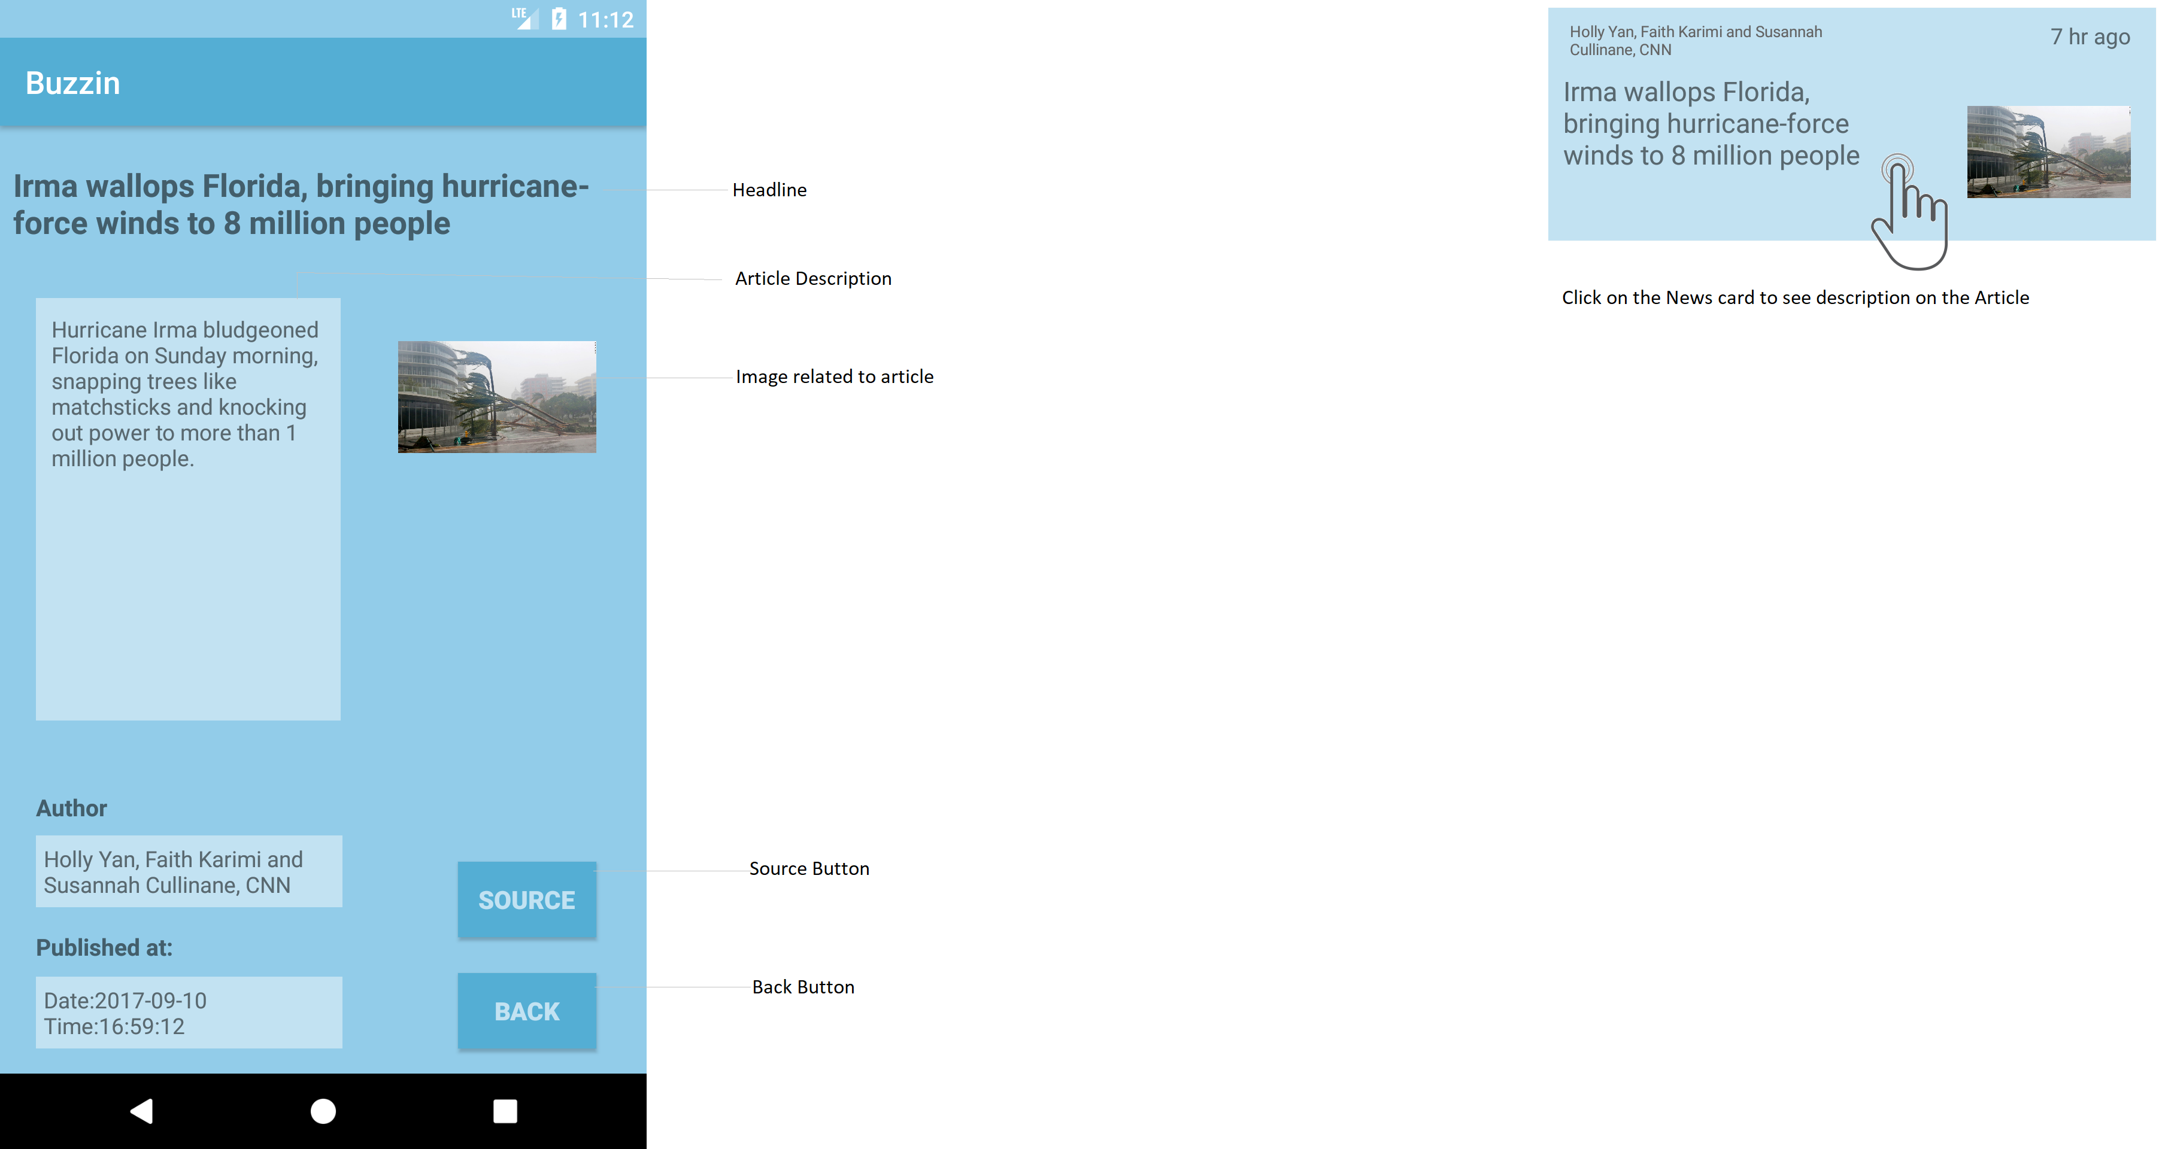

Slide 9
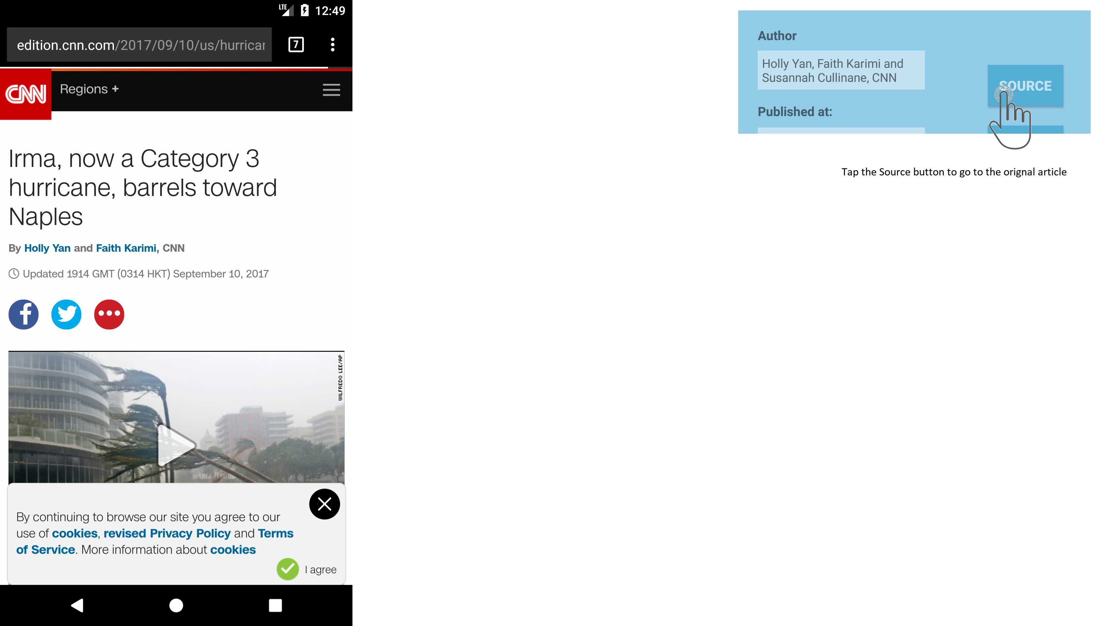
Original article will open in another app
Another app will be most commonly users default browser.

Slide 10
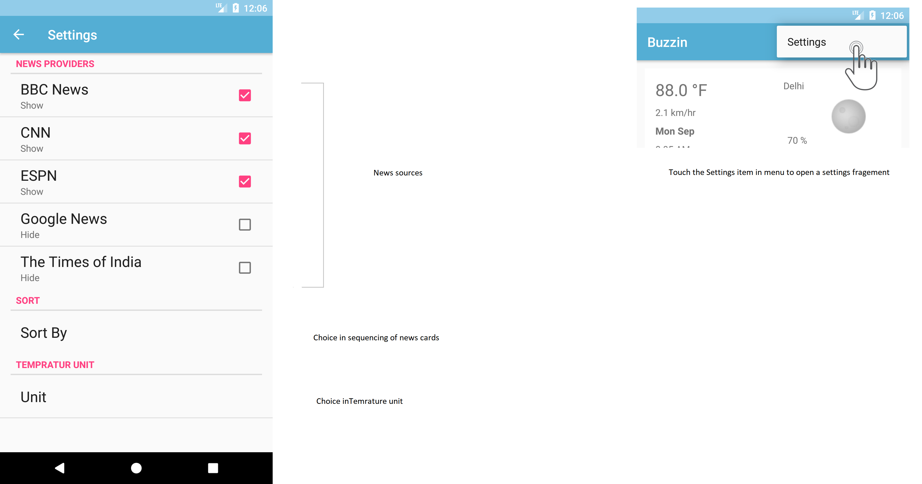

Slide 11
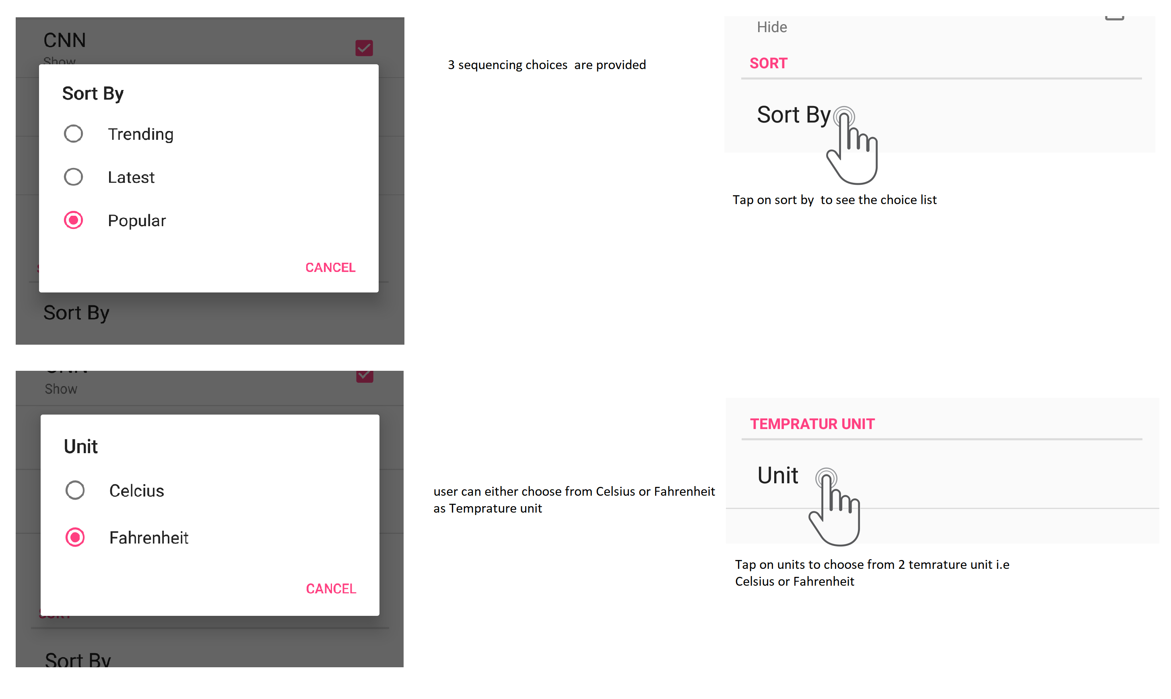

Slide 12
Pros and Cons of BUZZIN
Advantages
Disadvantages
User can see the weather and news cards in one screen.
User can select from different news providers for his news source.
Not available in landscape mode right now
User neither get alerts for trending news nor for bad weather.

Slide 13
Thank You

